Slide 1
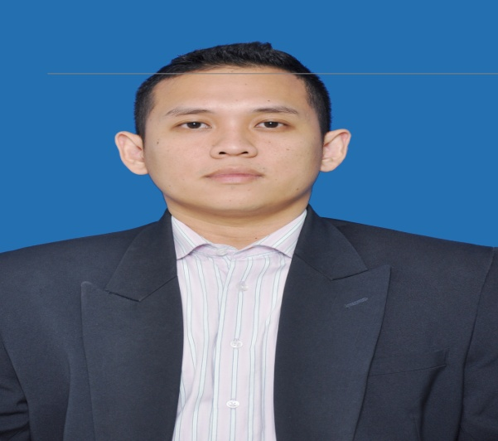
Zico Kemala Batin
Bintaro Park 2, blok G1, Tanggerang Selatan
+6281285324606
+6287787238728
Zico is electrical engineer who "accidentally" get into Music Industry, previously working as Sales Manager Physical & Digital at Universal Music Indonesia, member of Universal Music Group Int'l, the world's leading music company,he has vast knowledge in the music industry ,from production, warehousing until distribution , also from physical sales, digital sales to telco & digital sales to OTT player , digital marketing and business development area. Want to explore his skill to digital area, he moved to Tencent , as Head of Business development JOOX, in 1 year create JOOX become no 1 music streaming service in Indonesia Currently Zico working for Yonder Music Inc as country manager, Yonder Music is Yonder Music is a bold new feature - rich, digital music service that provides you with access to millions of songs to download and play, commercial free. Responsible for overall P & L Yonder Music Indonesia & growth the business in Indonesia and become face Yonder Music Indonesia
Country Manager Yonder Music Indonesia
April 2016 – Present
Yonder Music is Yonder Music is a bold new feature - rich, digital music service that provides you with access to millions of songs to download and play, commercial
Role & Responsibility
Responsible to overall P&L Indonesia Business Responsible to building & managing the country budget
Work with the executive management to ensure that the organization has the resources to enable it to achieve its plan, such as marketing funds, people & business tool
Responsible for the development brand partnership
Business development to increase profitability within managed the territory

Slide 2
Head of Business Development & Partnership JOOX Indonesia
April 2015 – Present
Tencent Founded in November, 1998, Tencent has grown into one of China's largest and most used Internet service portal. Since its establishment over the last decade, Tencent has maintained steady growth under its user-oriented operating strategies. On June 16, 2004, Tencent Holdings Limited (SEHK 700) went public on the main board of the Hong Kong Stock Exchange.
Role & Achievement
Create business model for monetizing JOOX in Indonesia & identify potential partner to have partnership with JOOX
Create & execute campaign in order to get new acquisitions new user + retentions existing users
Do presentation to potential client from other industry ie FMCG, OEM, FSI, Telco, Retail & get deal from them ( B2B2C business model )
Prepare all aspect before JOOX application launch
Responsible to get sponsorship from partner for TVC launching
Create campaign with label to increase VIP customer for JOOX application ( B2C business model )
Involve in marketing & promotion for in creative area, tactical area, BTL & event sponsorship
JOOX become market leader in Indonesia market in only 5 month since launch
Sucessfull close deal with multiple brand ie JBL, OPPO, FWD ( Insurance ), Levi’s, Kagum Hotel to become JOOX strategic partner
Sales Manager Physical & Digital Universal Music Indonesia
January 2014 – March 2015
Universal Music Indonesia part of Universal Music Group, Inc. (UMG Recordings, Inc., abbreviated as UMG) is an American-French worldwide music corporation that operates as a subsidiary of Paris-based French media conglomerate Vivendi. It claims to be the largest music corporation in the world. UMG also owns Universal Music Publishing Group, which is cited as the second largest music publishing company in the world.
Role & Achievement
Main responsible for production dept ie responsible in production physical product for new release , including deal with supplier to produce cd cover &cd product, maintain timeline in order meet schedule for release date & also responsible in repeat order production, for set up the quantity , timeline management & control warehouse stock level at the same time

Slide 3
Main responsible for sales dept ie responsible to sell all physical product to wholesale & retail, make sure the time line delivery, check sales daily basis, responsible to achieve target , help finance to collect debt from partner, responsible to create new distribution channel, responsible to retail marketing from budgeting, placement & executing
Main responsible for digital dept ie create program with telco to increase rbt revenue, create campaign Itunes to increase itunes revenue , monetizing youtube & vevo as well, responsible to achive digital target, talk to OEM partner to explore another digital opportunity & other digital partner
Sales Manager Universal Music Indonesia
May 2010 – December 2013
Universal Music Indonesia part of Universal Music Group, Inc. (UMG Recordings, Inc., abbreviated as UMG) is an American-French worldwide music corporation that operates as a subsidiary of Paris-based French media conglomerate Vivendi. It claims to be the largest music corporation in the world.UMG also owns Universal Music Publishing Group, which is cited as the second largest music publishing company in the world.
Role & Achievement
Main responsible for sales dept ie responsible to sell all physical product to wholesale & retail, make sure the time line delivery, check sales daily basis, responsible to achieve target , help finance to collect debt from partner, responsible to create new distribution channel, responsible to retail marketing from budgeting, placement & executing
Get promotion to become Sales Physical, Digital & Distribution
Sales Coordinator Universal Music Indonesia
March 2007 – April 2010
Universal Music Indonesia part of Universal Music Group, Inc. (UMG Recordings, Inc., abbreviated as UMG) is an American-French worldwide music corporation that operates as a subsidiary of Paris-based French media conglomerate Vivendi. It claims to be the largest music corporation in the world.UMG also owns Universal Music Publishing Group, which is cited as the second largest music publishing company in the world.
Role & Achievement
Responsible in retail placement, racking, telesales to customer, retail visit, retail promo

Slide 4
Main responsible for sales dept ie responsible to sell all physical product to wholesale & retail, retail promotion, create campaign with retaill partner
Get Promotion to become Sales Manager
Personal Information
Graduate from Trisakti University Jakarta ( Bachelor Electrical Engineering )
Born in Jakarta 1st April 1984

